Slide 1
A very short introduction to… Density functional theory
Modelling low-dimensional materials, week 2 Dr Igor Roncevic

Slide 2
Density functional theory
1926 Schrödinger equation
1927 Hartree’s “self-consistent field” (SCF) method
1930 Fock points out that Hartree’s wavefunction does not obey exchange symmetry
1935 “Self-consistent field, with exchange”, birth of the modern Hartree-Fock (HF) method

Slide 3
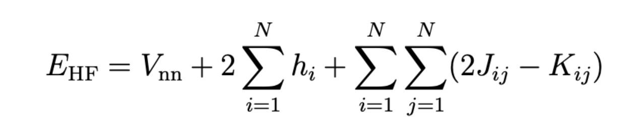
Hartree-Fock (1930s)
internuclear repulsion
free (B–O approximation)
electron-electron repulsion
two-electron integrals
expensive
Kinetic energy and electron-nuclear attraction
one-electron integrals
very cheap
HF is approximate, it localises electrons too much.
Systematic improvement requires adding more two-electron integrals.
We don’t like two-electron integrals. Is there an alternative?

Slide 4
Density functional theory
1926 Schrödinger equation
1927 Hartree’s “self-consistent field” (SCF) method
1930 Fock points out that Hartree’s wavefunction does not obey exchange symmetry
1935 “Self-consistent field, with exchange”, birth of the modern Hartree-Fock (HF) method
1950s Computers become strong enough to calculate small molecules
1950s + δ Computational physicists and chemists realise that HF has poor accuracy
1964 Hohenberg-Kohn theorems:
1. The ground state of a system is completely determined by its density.
2. The exact ground-state density minimises the total energy.

Slide 5
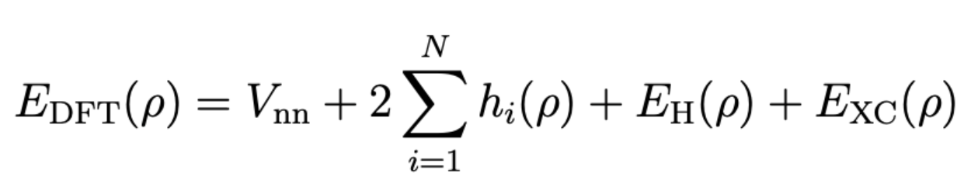
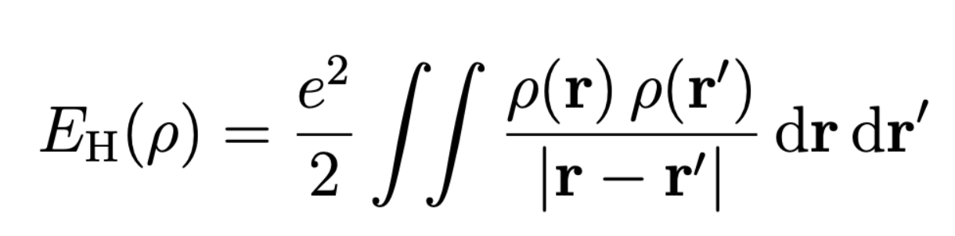
Density functional theory
classical electron-electron repulsion, introduces SIE
exchange and correlation
How to determine?
Pure DFT is an exact theory without two-electron integrals!
Classical repulsion (E_{H}) causes too much delocalisation (self-interaction error, SIE).

Slide 6
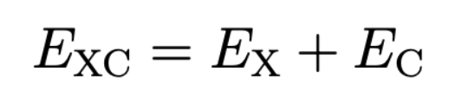
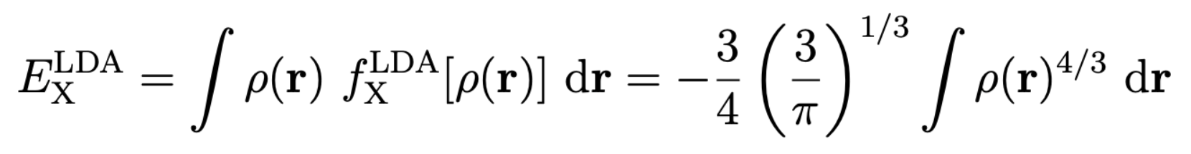
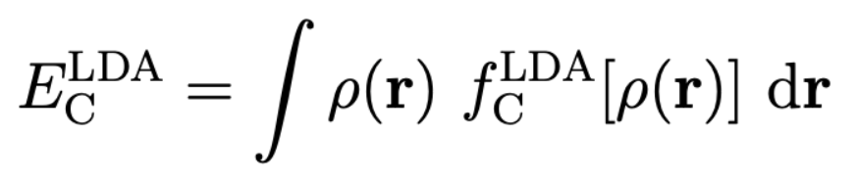
Density functional theory
exchange and correlation
How to determine?
where is some parametrised function of the density.
Pure DFT is an exact theory without two-electron integrals!
Exchange & correlation (E_{XC}): should fix everything, but we don’t know what looks like.
We can make guesses, E_{XC} needs to cancel self-interaction introduced by E_{H}
account for the exchange hole, E_{kin}…

Slide 7
Density functional theory
1926 Schrödinger equation
1927 Hartree’s “self-consistent field” (SCF) method
1930 Fock points out that Hartree’s wavefunction does not obey exchange symmetry
1935 “Self-consistent field, with exchange”, birth of the modern Hartree-Fock (HF) method
1950s Computers become strong enough to calculate small molecules
1950s + δ Computational physicists and chemists realise that HF has poor accuracy
1964 Hohenberg-Kohn theorems:
1. The ground state of a system is completely determined by its density.
2. The exact ground-state density minimises the total energy.
1965 Walter Kohn’s local density approximation (LDA)
1970s–1980s development of various GGA methods
1994 PBE functional (Perdew, Burke, Ernzerhof)
1994 B3LYP hybrid functional (Becke, Lee, Yang, Parr)

Slide 8
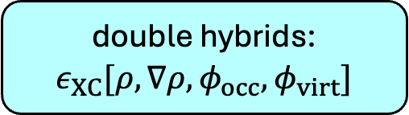
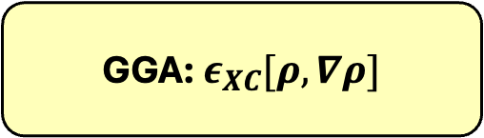
Types of functionals
“Heaven” of exact accuracy
Double hybrid DFT
Mixes in PT2 correlation exchange, introducing 2e-integrals over occupied and virtual orbitals: E_{XC} = a E_{X,HF} + b E_{X,DFT} + c E_{C,DFT} + d E_{C,PT2}
double hybrids: $ε_{XC}[ρ, ∇ρ, φ_{occ},φ_{virt}]$
Hybrid DFT
Mixes in HF exchange, reintroducing 2e-integrals over occupied orbitals: E_{XC} = a E_{X,HF} + b E_{X,DFT} + E_{C,DFT}
hybrids: $ε_{XC}[ρ, ∇ρ, φ_{occ}]$
GGA: $ε_{XC}[ρ, ∇ρ]$
Pure DFT
E_{XC} fully determined by density (LDA) and its gradient (GGA)
In principle:
Choose some basis
Vary ρ until E_{tot} is minimised
LDA: $ε_{XC}[ρ]$
Hartree “Earth”

Slide 9
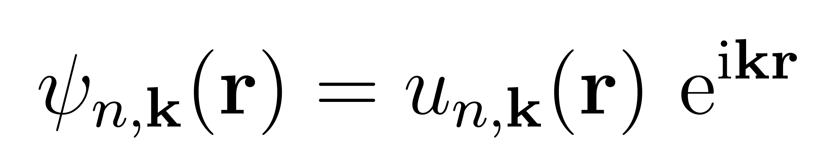
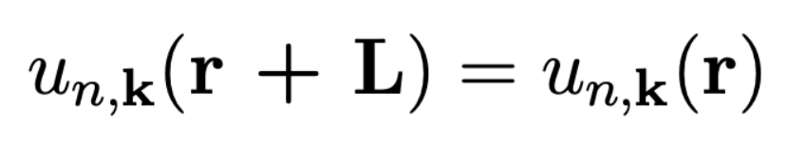
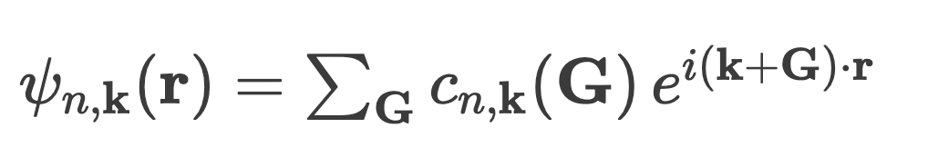
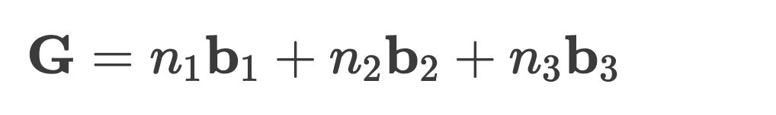
Periodic DFT
Bloch theorem:
Bloch phase factor
nth one-electron state
cell-periodic part (L = lattice parameter)
In plane-wave basis:
with:
where n are integers and b are reciprocal lattice unit vectors.
We minimise E_{tot} by varying these coefficients.

Slide 10
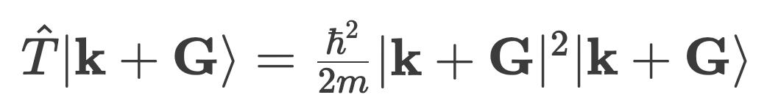
Periodic DFT
In plane-wave basis:
with:
where n are integers and b are reciprocal lattice unit vectors.
Plane waves are nice because the kinetic energy is diagonal:
For practical calculations we define our basis by setting a maximum kinetic energy.
PW are not so good for describing core electrons, as these need PWs with enormous kinetic energy. So, we use pseudopotentials to treat these (we won’t go into details).
We minimise E_{tot} by varying these coefficients.

Slide 11
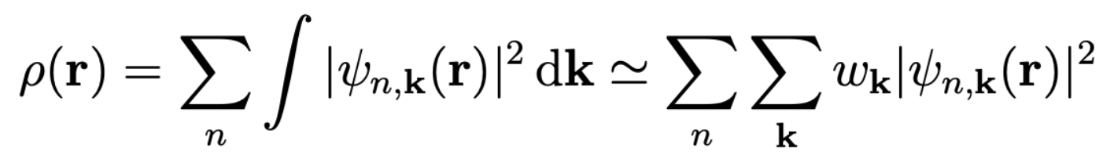
Periodic DFT
Total density is obtained by summing over occupied states n and a finite k grid:
k-point weights
When using GGA/LDA, ρ(r) completely determines ψ(r)
To plot band structures, we can:
Converge ρ(r) and E_{tot} wrt the k-grid: self-consistent field (SCF) calculation
Freeze ρ(r) and evaluate any k-grid: non-SCF (NCSF) calculation
Run various post-processing on ψ obtained above.

Slide 12

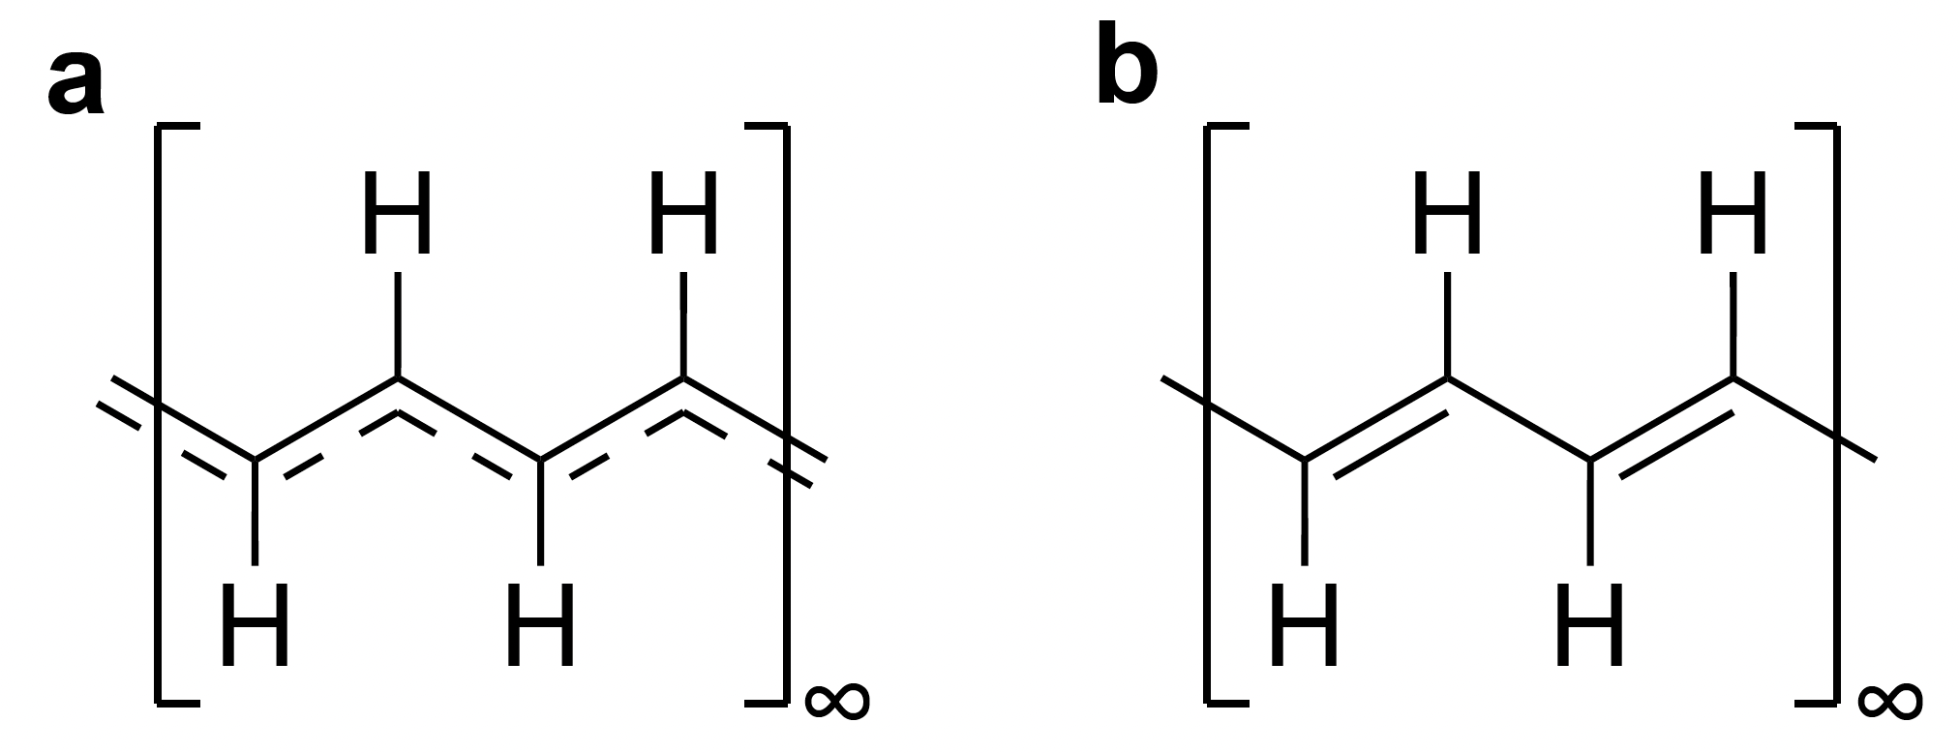
Peierls distortion in trans-polyacetylene (t-PA)
cumulene
polyene
Following the instruction in the Google Colab notebook:
Compute the density of states and band structure of the provided cumulene geometry.
Optimise the geometry of t-PA.
Compute the density of states, band structure of relaxed polyenic t-PA.
Fit your results onto the Su–Schrieffer–Heeger model.
Discuss.

Slide 13
To begin, open your terminal and type (or scan QR code and copy):
git clone https://github.com/ironcevic/Modelling_low_dimensional_materials.git

Slide 14
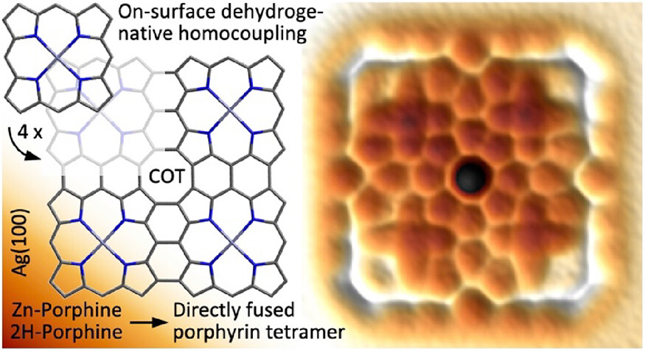
A real-life example: Peierls distortion in 2D
1D porphyrin chains do not undergo Peierls distortion (Science 2001, 293, 79.)
N → ∞, band gap → 0
What about 2D sheets?
J. Am. Chem. Soc. 2023, 145, 967–977.
Nature Commun. 2023, 14, 6308.

Slide 15
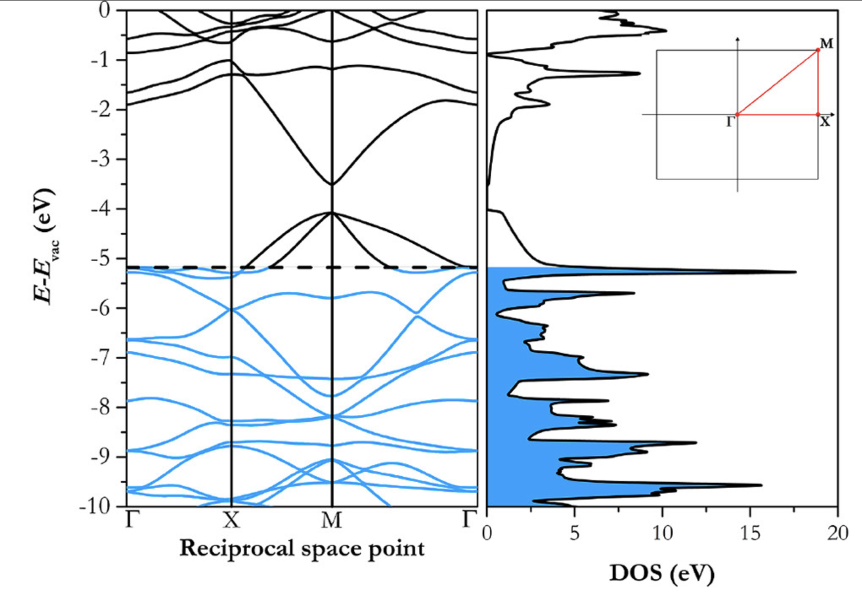
Theory: Zn porphene is a metallic conductor
Int. J. Quantum Chem. 2009, 109, 1584-1597.
Int. J. Quantum Chem. 2011, 111, 3230-3238.
RSC Adv. 2013, 3, 7016-7022.
J. Phys. Chem. C 2018, 122, 23790-23798.
J. Mater. Chem. A 2019, 7, 11944-11952.
Experiment: no metallic conductivity in ~1000⨯1000 Å sheets!
Nature Commun. 2023, 14, 6308.

Slide 16
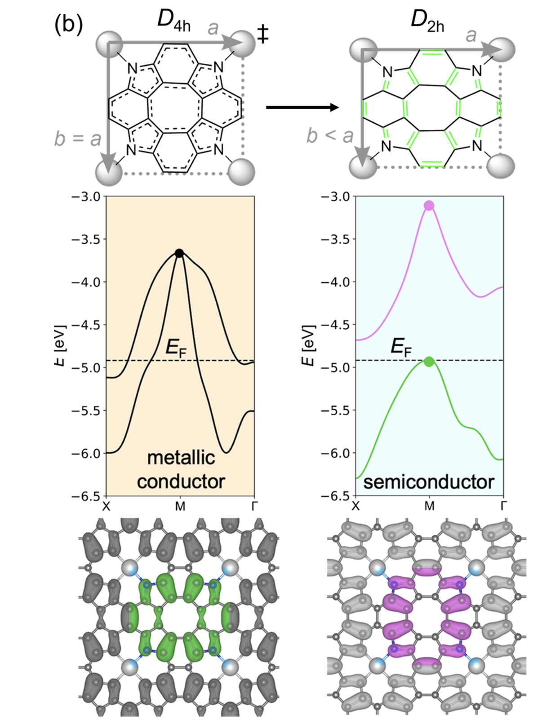
Frontier bands of Zn porphene
JACS 2024, 146, 3992.

Slide 17
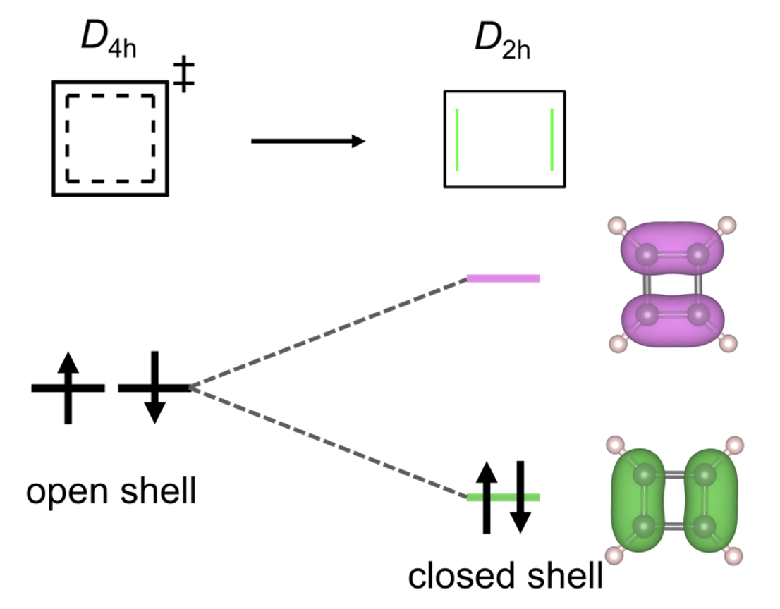
Frontier bands of Zn porphene
JACS 2024, 146, 3992.

Slide 18

Frontier bands of Zn porphene
Ivan Pavlak
JACS 2024, 146, 3992.

Slide 19
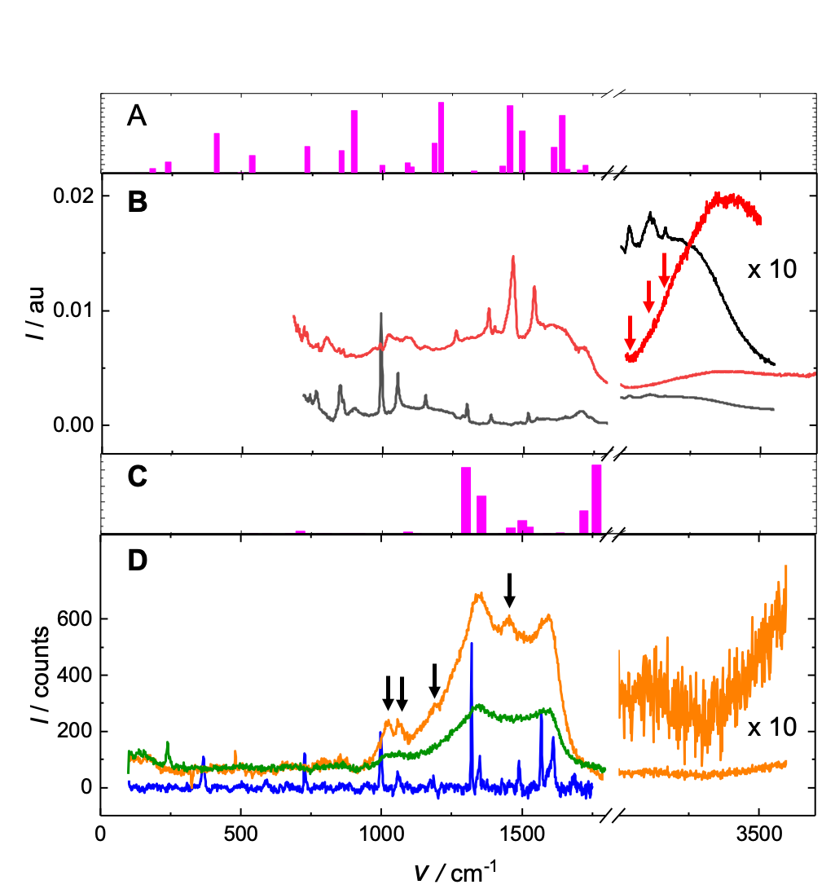
IR
Raman
Nature Comm. 2023, 14, 6308.

